Slide 1
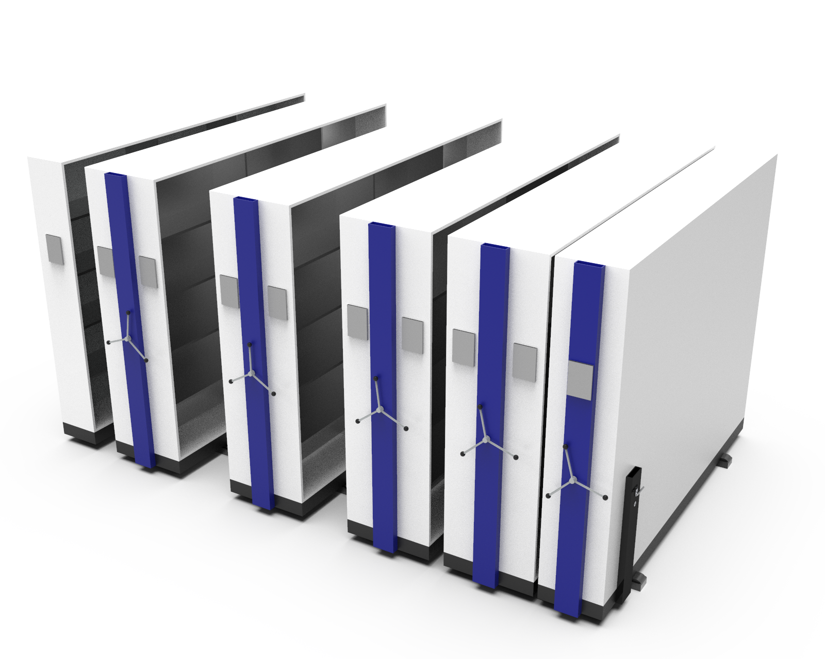
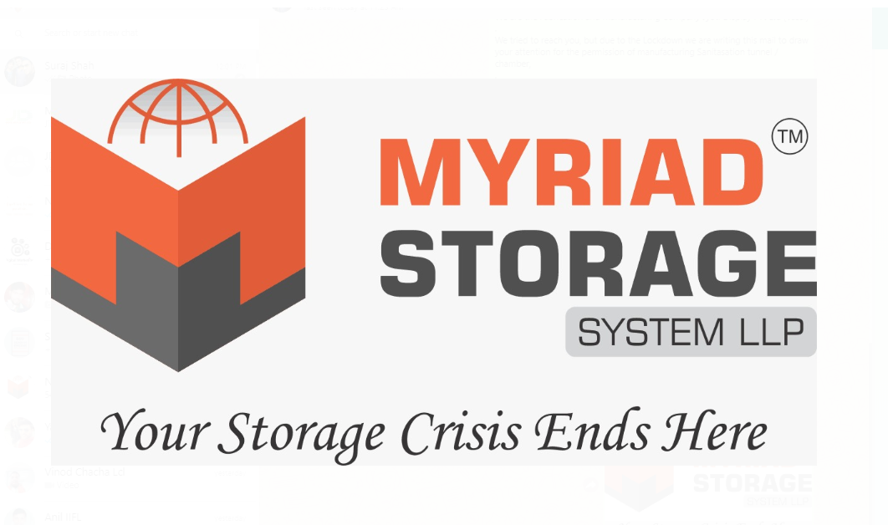
Compactor Storage System
Myriad Storage System LLP

Slide 2
Myriad Storage System LLP
Our Compactor Storage Manufacturing Process.
This presentation is all about how our manufacturing team take steps in the production of compactor Storage system, file storage system, mobile compactor and industrial lockers.
With all experienced and skilled Labors, we have the powerful team for all versions of storage system production in our factory.
This presentation will help new beginner and customers who are interested in more depth understanding of new generation compactor storage system. We have explained and covered most essential steps involved in the manufacturing process.

Slide 3
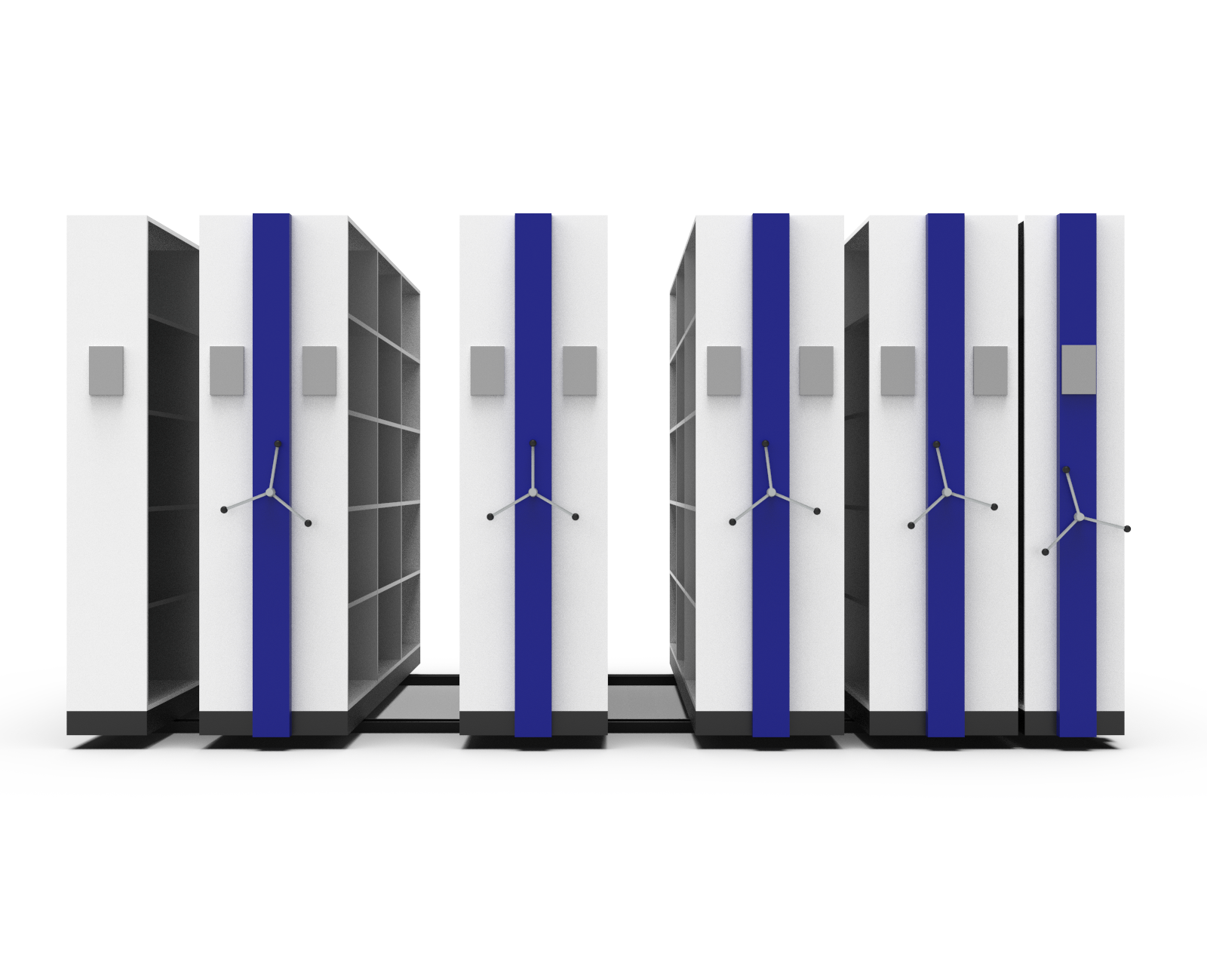
Myriad storage System LLP
About Our Compactor Storage System
Our Compactor Storage System is designed and developed to optimized the space in commercial sector as well as hospitals, institutes, business sector, industries, Government sectors, Schools, Colleges and more.
Maximizes the Uses and Productivity
Our Compactor are more into optimize the usable space and maximize the productivity of the organization. Indirectly it contributes in the final output of the team. Our Storage systems are durable and comes advanced locking system. We are also working on making the locking system with new generation digital password protected locking technology. Very soon we will bring it live in our front end marketplace.

Slide 4
Manufacturing Process
Compactor Storage System, File Compactor and Mobile Compactor.

Slide 5
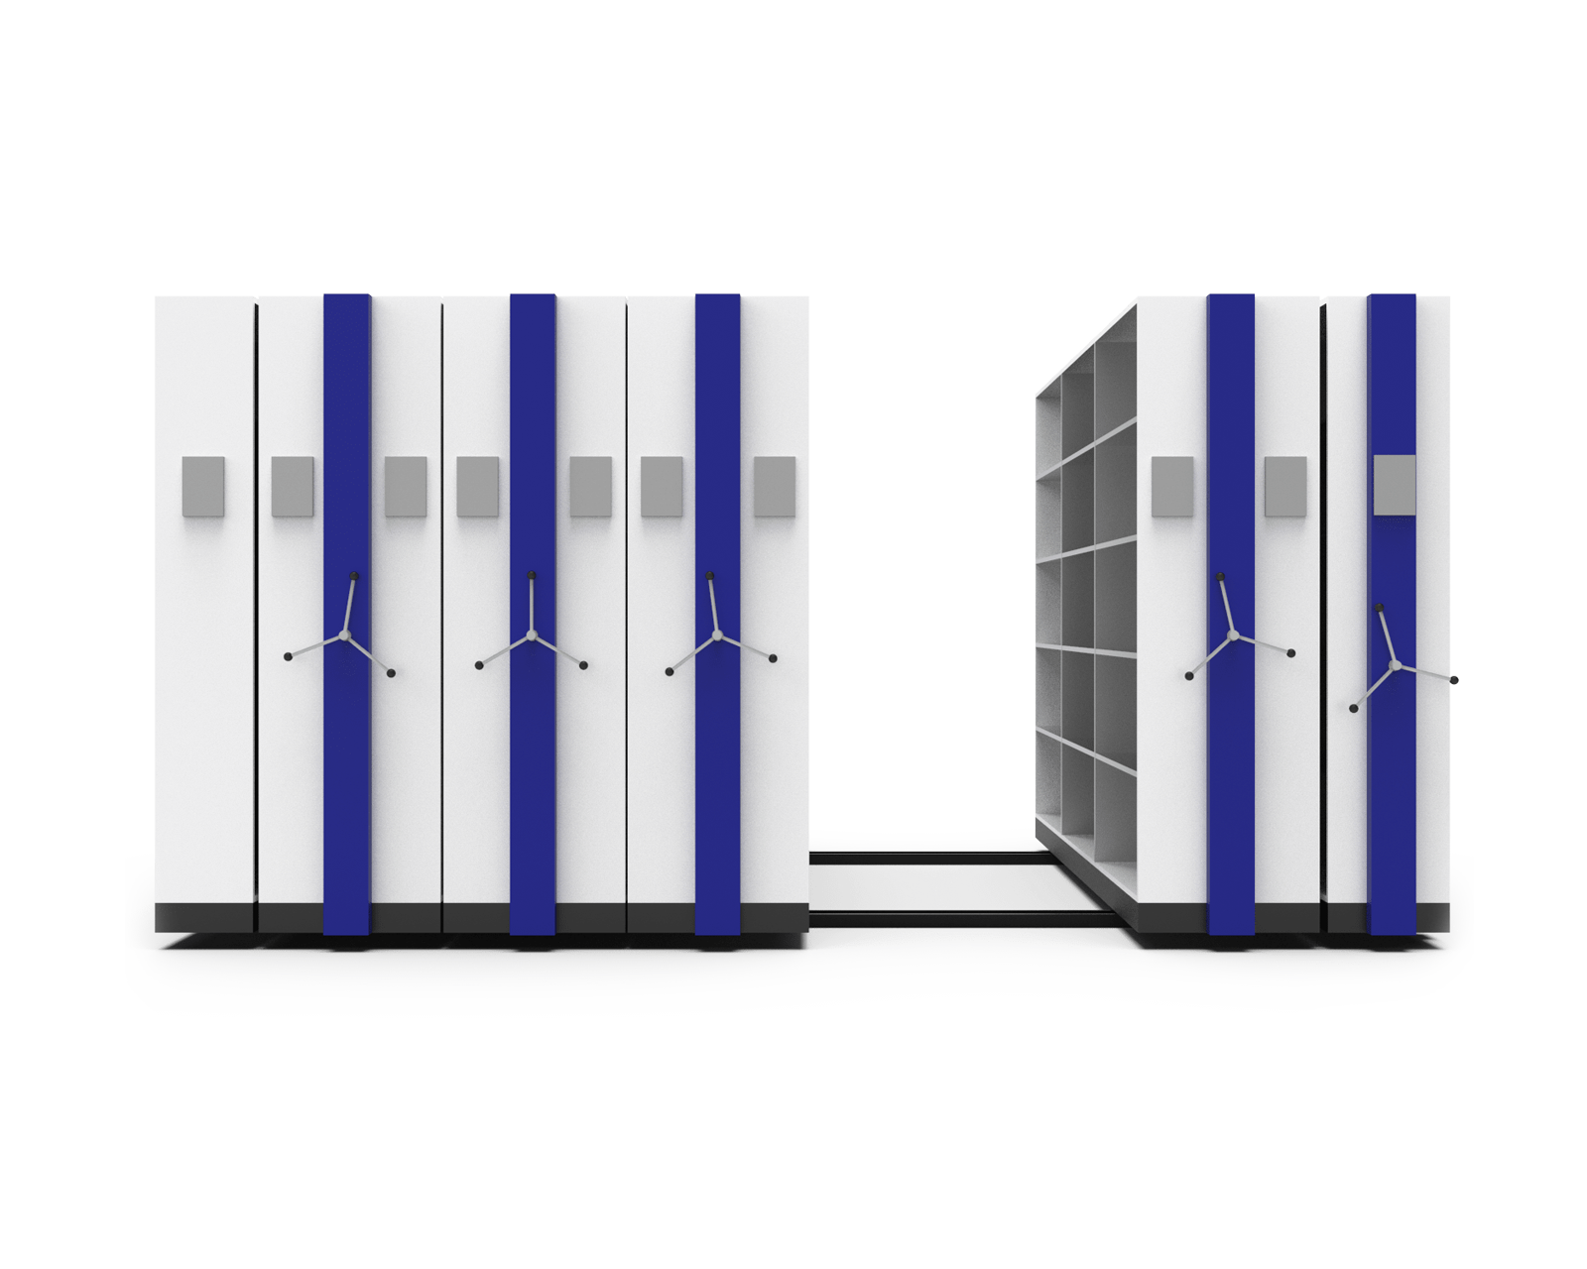
1. Production Strategy
Team organization and Responsibilities.
Before every production, our whole team participate in the strategy creation where we check the available resources and on going projects where our current labors are involved.
We learn the complete requirement of the client and its quantity for the compactor storage system. Every different client has a separate requirement specification for their space optimization on working area. We organise the team and mark them with relevant responsibilities for the production and the projects.
Meanwhile our research team works on the design of file compactor storage system to start the action.

Slide 6
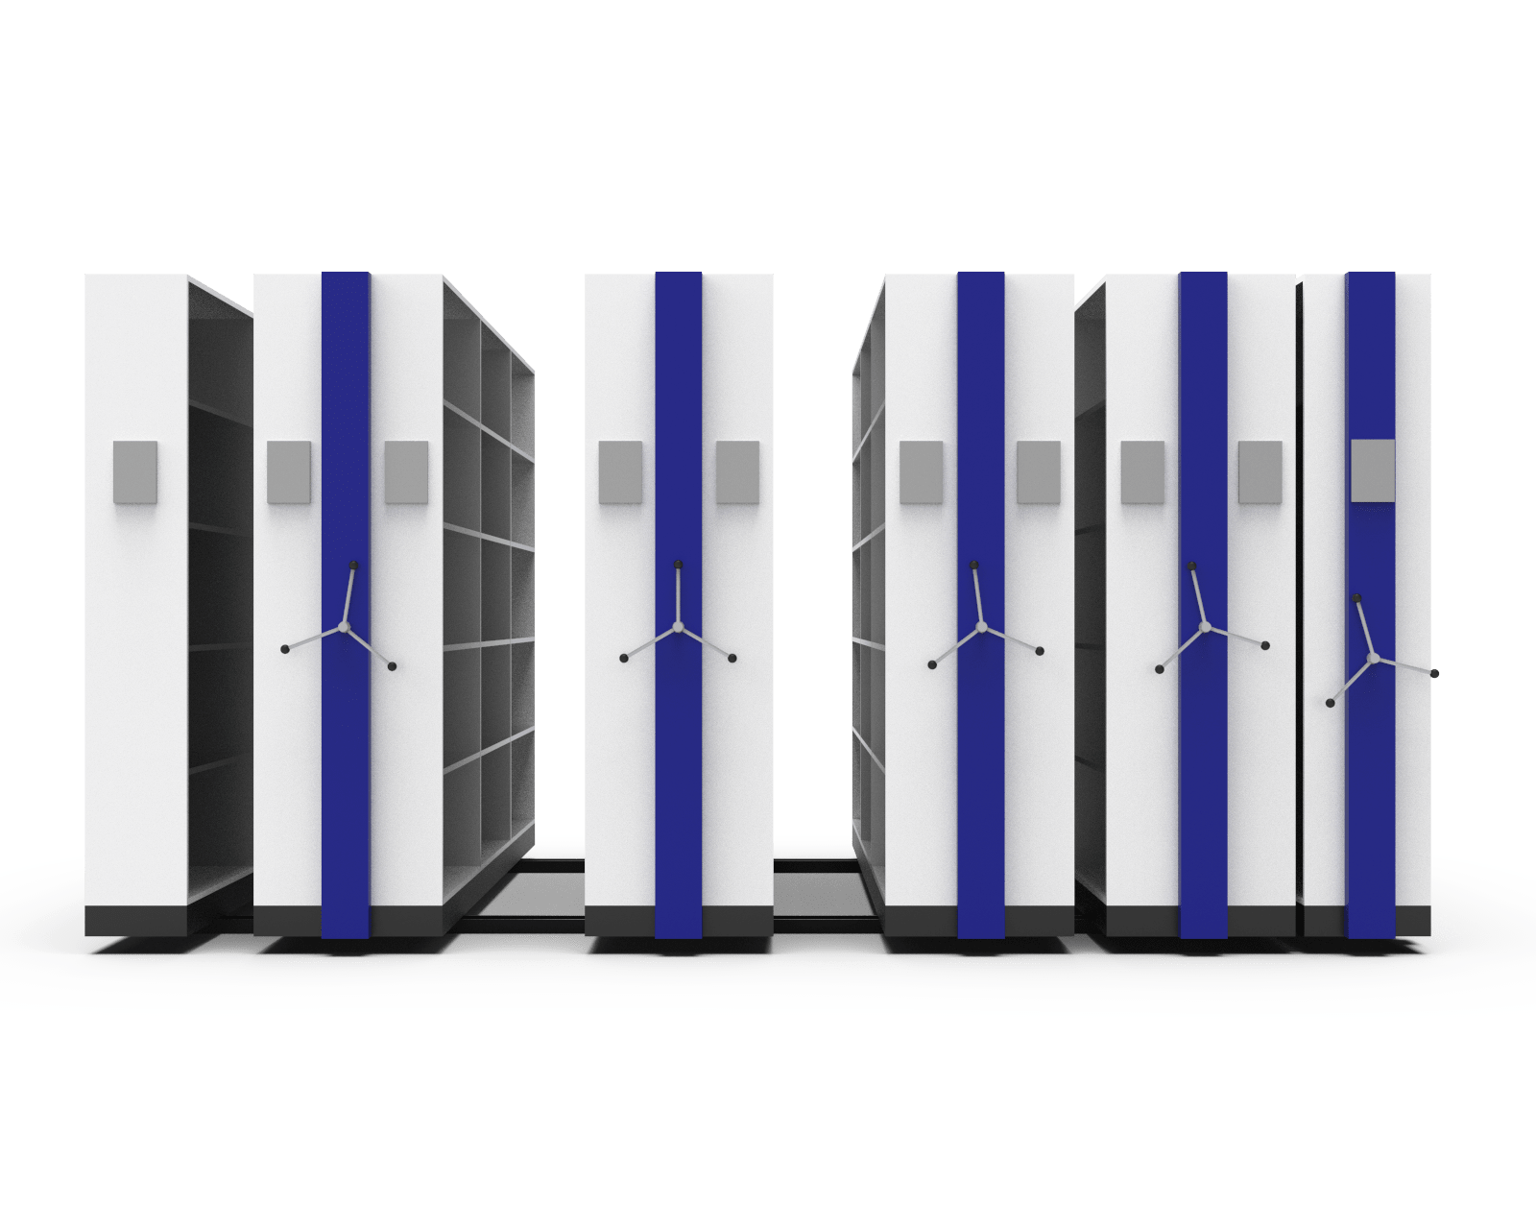
2. Design and Development
3D Design and Modeling
Here our expertise 3D Design professional and engineers who takes care of all required modeling of compactor storage system as per the clients requirements.
This team also carries out the cost of raw material required in the production process.
This helps our Purchase team to organize the raw material and store keeping with all required essentials. The next steps is to review and finalize the design provided by 3D team and here our Purchase team comes in actions.

Slide 7
3. Purchase and Procurements
The Smart Purchase team
Here our smart purchase and procurement team carry forward the project by reading and analyzing the draft provided by 3D Design and development team.
The draft included all required essential for the manufacturing process of the concerned compactor or file storage system before the deadline.
Why we call our Purchase team Smart?
I appreciate the smartness of our team, because they know how to maintain the clever relationship with all our vendors and suppliers of raw materials. They makes the material available in store with helpful credit period from the vendors and material suppliers.

Slide 8
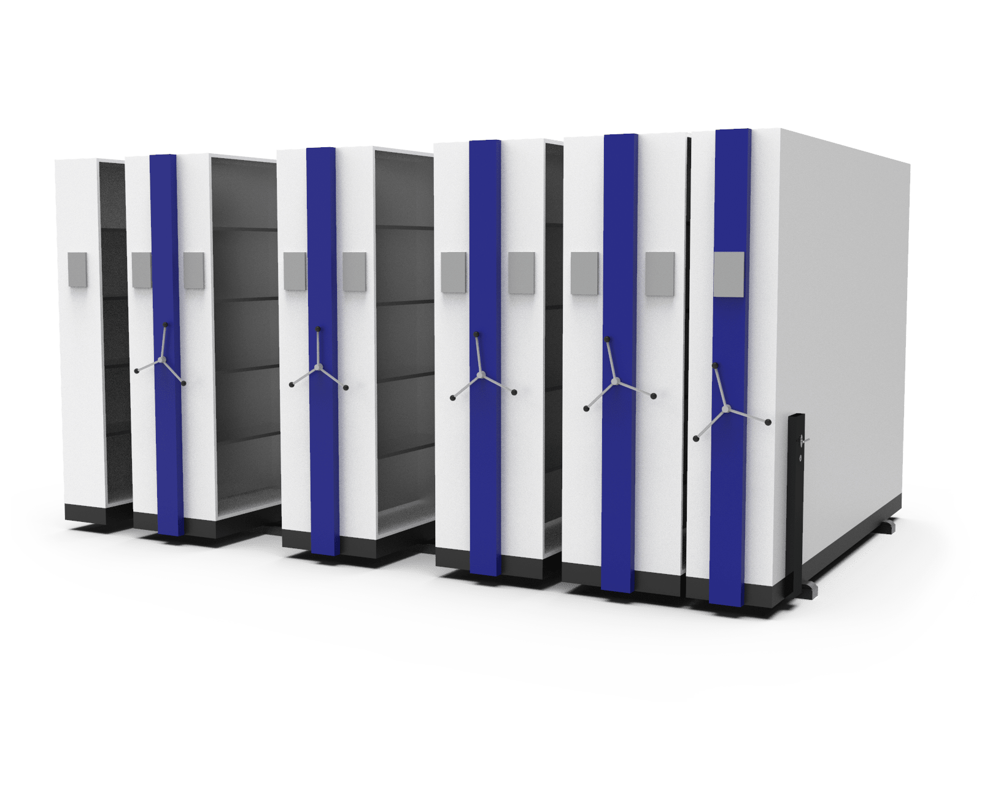
Compactor Storage System Pictures

Slide 9
4. The Fabrication Shop
Here comes the Fabrication and most actionable space.
We live here, our maximum efforts and manpower are involved here in Fabrication house. We have our hardworking metal expert team who enjoys the manufacturing process here. They like action, noise and productivity.
Fabrication involved all metal cutting, bending and welding. It is the very first phase where we see the compactor storage taking its shape in real world. We do several manual adjustments with handwork, but most of the action are done by our advanced cnc machine.

Slide 10
5. The Paint Shop
The Shape gets its color here in Painting Shop
Yes, after the fabrication we process ahead the compactors storage system for painting house, here you will see the hard built body gets its beautiful colors and long lasting protective layers of powder coating for long life.
We have customization for mobile compactor storage system manufacturing in Mumbai, Since our headquarter is in Mumbai. We also deal with all India with an ever active dispatch team for any corners and city of India. Whether its Hyderabad, Delhi, Kolkata or Surat.
Here comes our Dispatch team.

Slide 11
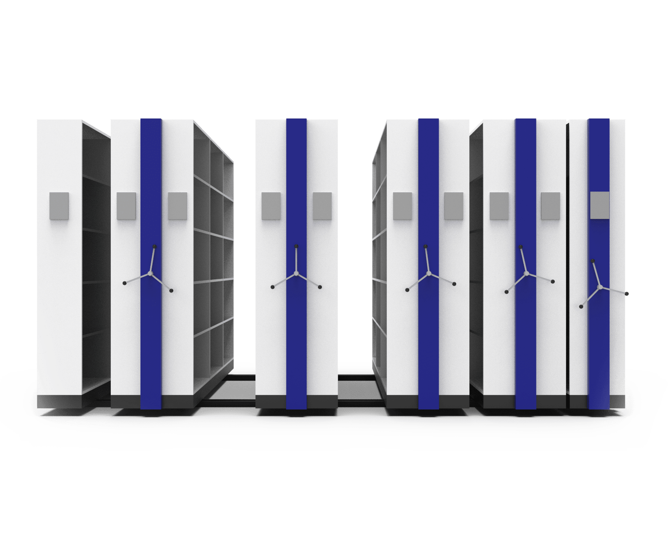
Compactor Storage System Pictures

Slide 12
6. Ready for Dispatch and Installation
The New Mobile Compactor Storage System is ready to go
Yes, After the whole process from 3D design to Painting of mobile compactor or file compactor storage system the manufacturing process steps ahead to deliver and dispatch the product to the end client. Here we deal with all industrial states and cities in India.
With Delivery and Dispatch we also process the finished installation of the storage system at Client space. Before delivery and after installation our team tests and review the product as per the initial requirements received.
Want to learn more about? Check our Mobile Compactor for more information.

Slide 13
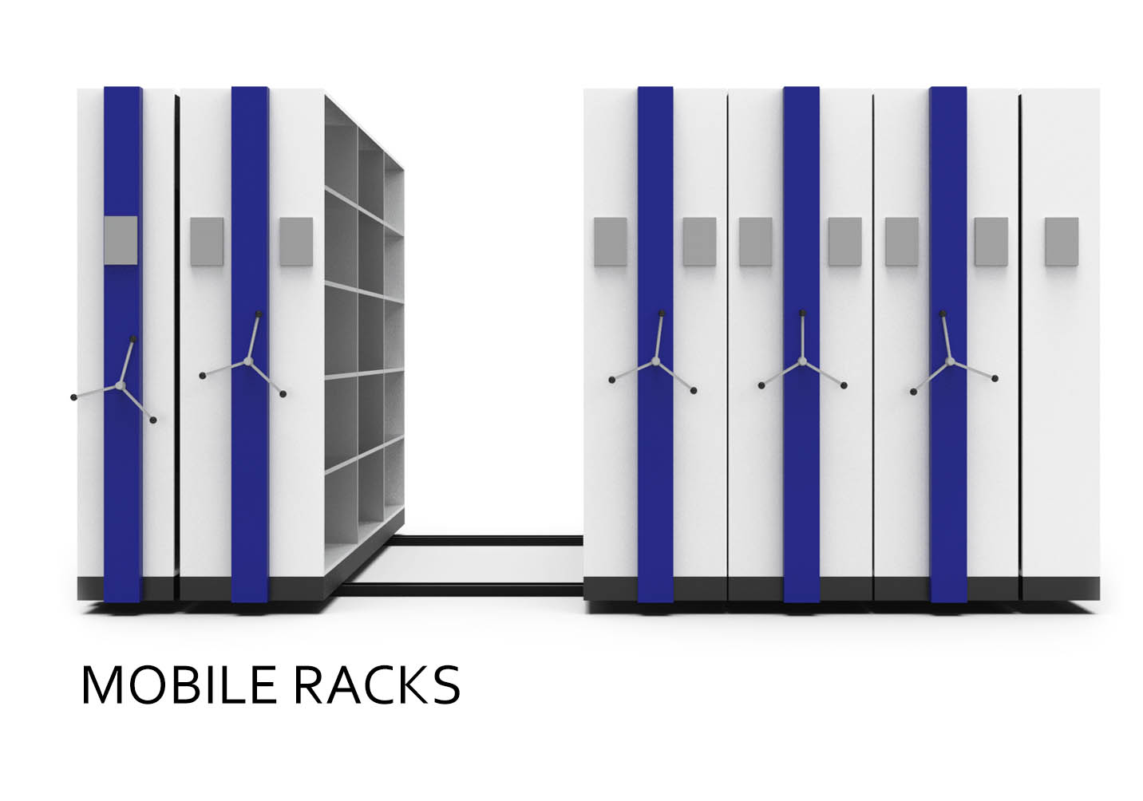
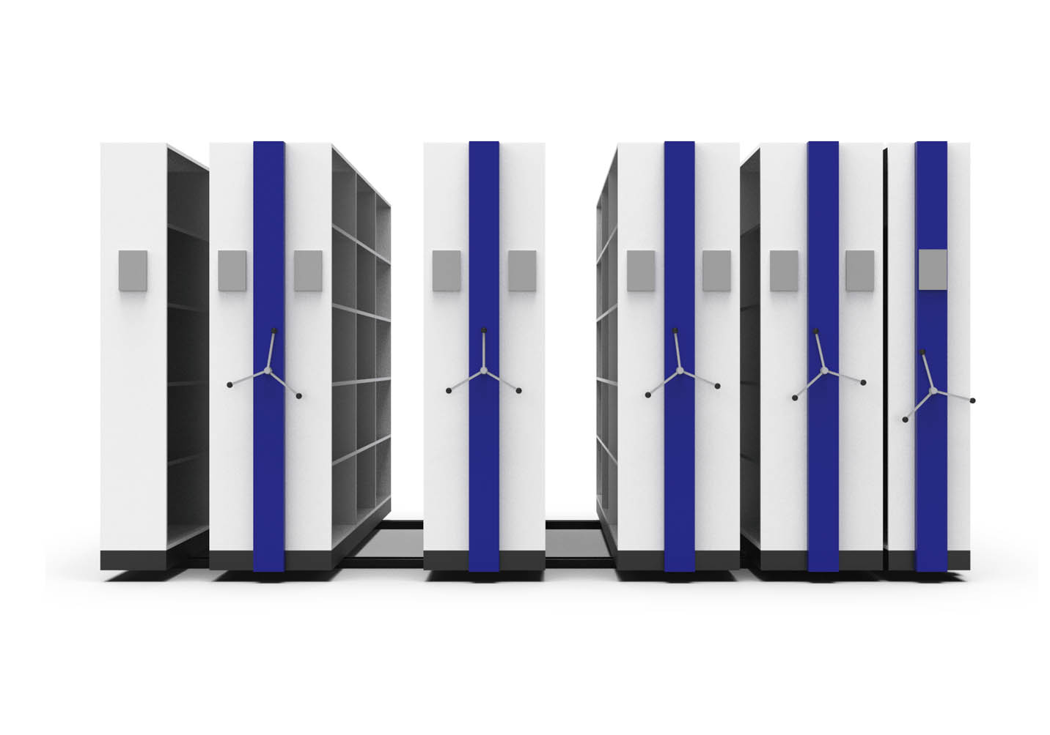
Mobile Compactor Storage System Pictures

Slide 14
Useful Links To Know More
Learn More about Myriad Storage System LLP, A Leading compactor manufacturer in India. Feel free to get in connect with us, we will be happy to help and explore the storage industries.
Myriad Storage System LLP
About Us
Compactor Storage System
Mobile Compactor
Industrial Lockers
Our Blogs
Contact Us

Slide 15
Thank You
Myriad Storage System LLP | Compactor Storage System Manufacturer

